Slide 1

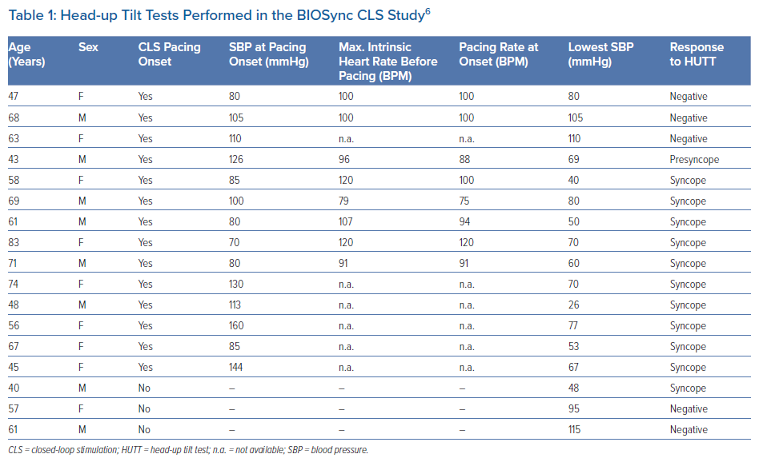
Tomaino M, Russo V, Giacopelli D, Gargaro A, Brignole M
Head-up Tilt Tests Performed in the BIOSync CLS Study
Citation: Arrhythmia & Electrophysiology Review 2021;10(4):244–9.
https://doi.org/10.15420/aer.2021.45

