Slide 1
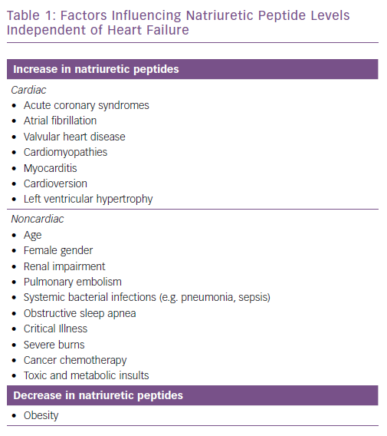
Brunner-La Rocca HP, Sanders-van Wijk S
Factors Influencing Natriuretic Peptide Levels Independent of Heart Failure
Citation: Cardiac Failure Review 2019;5(1):44–9.
https://doi.org/10.15420/cfr.2018.26.1

