Slide 1
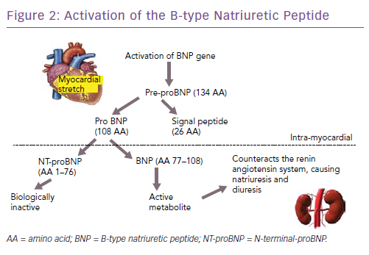
Nadar SK, Shaikh MM
Figure 2: Activation of the B-type Natriuretic Peptide
Citation: Cardiac Failure Review 2019;5(1):50–6.
https://doi.org/10.15420/cfr.2018.27.2

