Slide 1
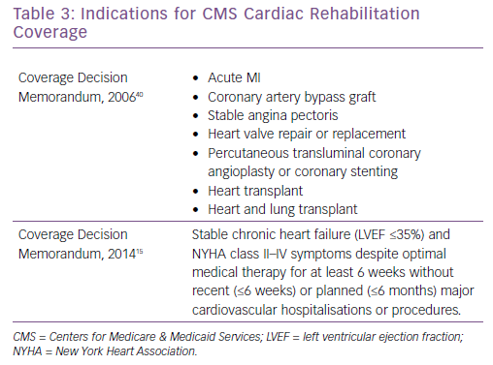
Morris JH, Chen L
Indications for CMS Cardiac Rehabilitation Coverage
Citation: Cardiac Failure Review 2019;5(1):57–61.
https://doi.org/10.15420/cfr.2018.31.1

