Slide 1
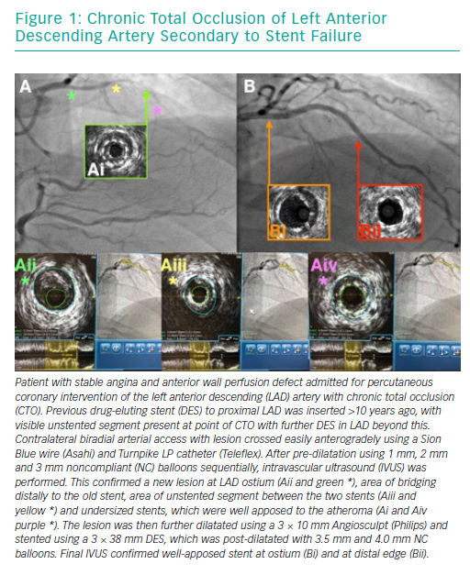
Pal N, Din J, O’Kane P
Chronic Total Occlusion of Left Anterior Descending Artery Secondary to Stent Failure
Citation: Interventional Cardiology Review 2019;14(1):10–6
https://doi.org/10.15420/icr.2018.39.1

