Slide 1
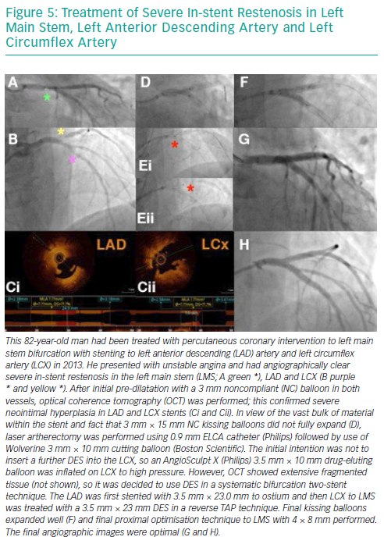
Pal N, Din J, O’Kane P
Treatment of Severe In-stent Restenosis in Left Main Stem, Left Anterior Descending Artery and Left Circumflex Artery
Citation: Interventional Cardiology Review 2019;14(1):10–6
https://doi.org/10.15420/icr.2018.39.1

