Slide 1
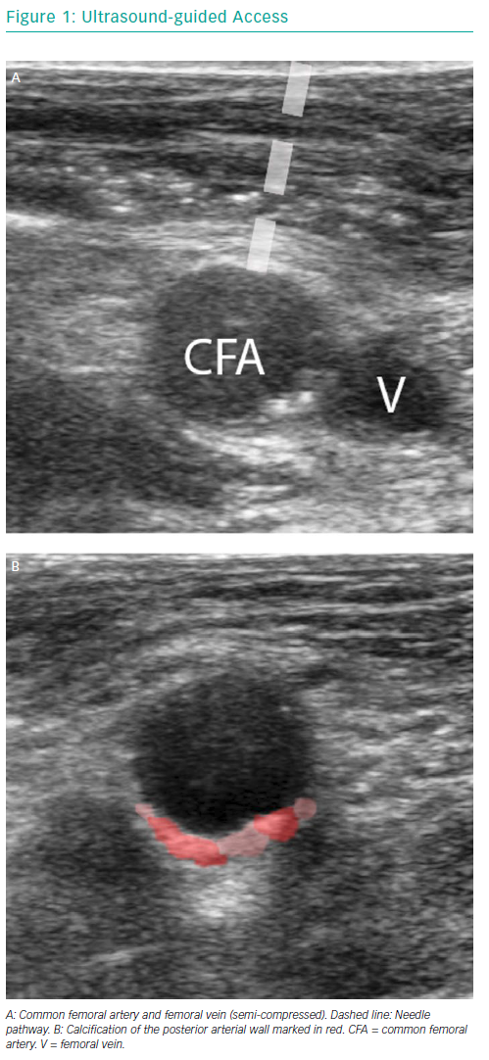
van Wiechen MP, Ligthart JM, Van Mieghem NM
Ultrasound-guided Access
Citation: Interventional Cardiology Review 2019;14(1):17–21
https://doi.org/10.15420/icr.2018.36.1

