Slide 1
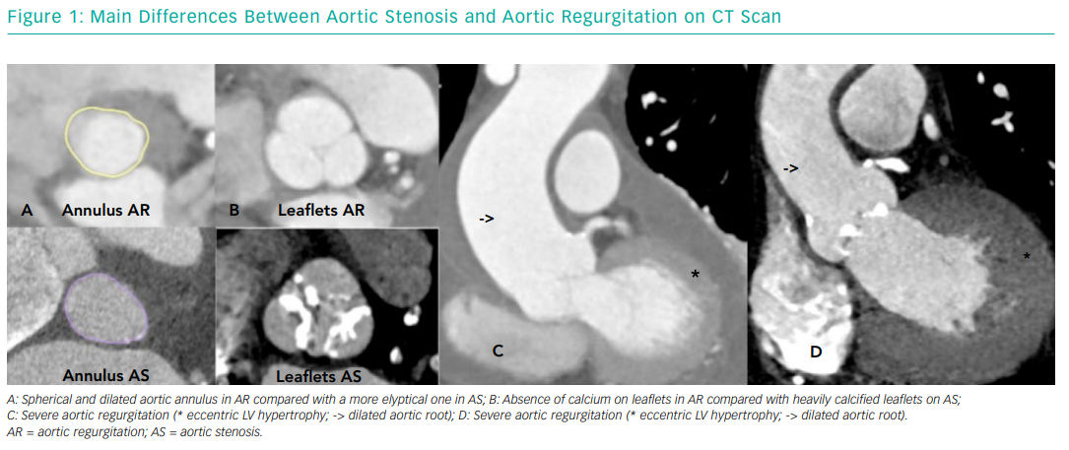
Arias EA, Bhan A, Lim Z, Mullen MJ
Main Differences Between Aortic Stenosis and Aortic Regurgitation on CT Scan
Citation: Interventional Cardiology Review 2019;14(1):26–30
https://doi.org/10.15420/icr.2018.37.1

