Slide 1
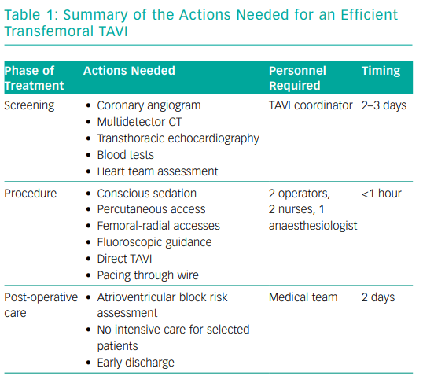
Tchétché D, de Biase C, Brochado B, Mastrokostopoulos A
Summary of the Actions Needed for an Efficient Transfemoral TAVI
Citation: Interventional Cardiology Review 2019;14(1):31–3
https://doi.org/10.15420/icr.2018.28.2

