Slide 1
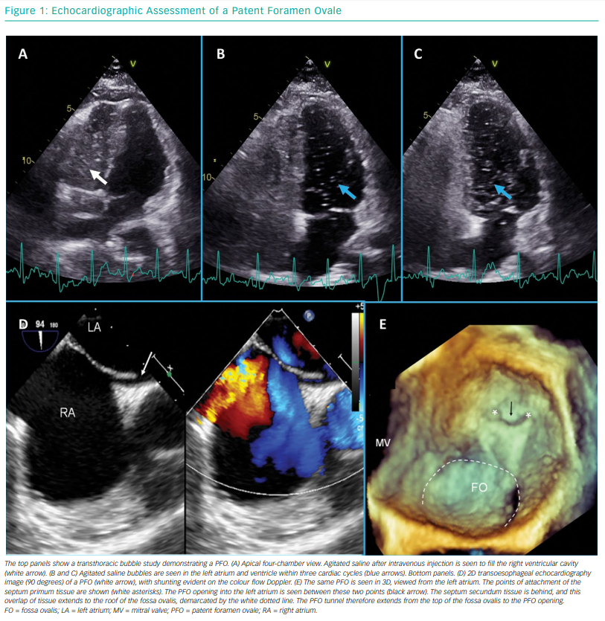
Giblett JP, Abdul-Samad O, Shapiro LM, Rana BS, Calvert PA
Echocardiographic Assessment of a Patent Foramen Ovale
Citation: Interventional Cardiology Review 2019;14(1):34–41
https://doi.org/10.15420/icr.2018.33.2

