Slide 1
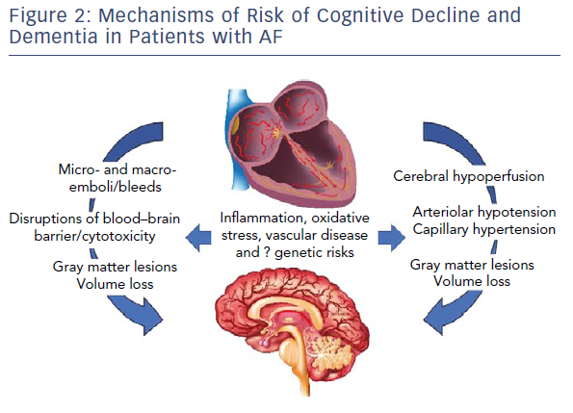
Bunch TJ, Galenko O, Graves KG, Jacobs V, May HT
Mechanisms Of Risk Of Cognitive Decline And Dementia In Patients With AF
Citation: Arrhythmia & Electrophysiology Review 2019;8(1):8–12
https://doi.org/10.15420/aer.2018.75.2

