Slide 1
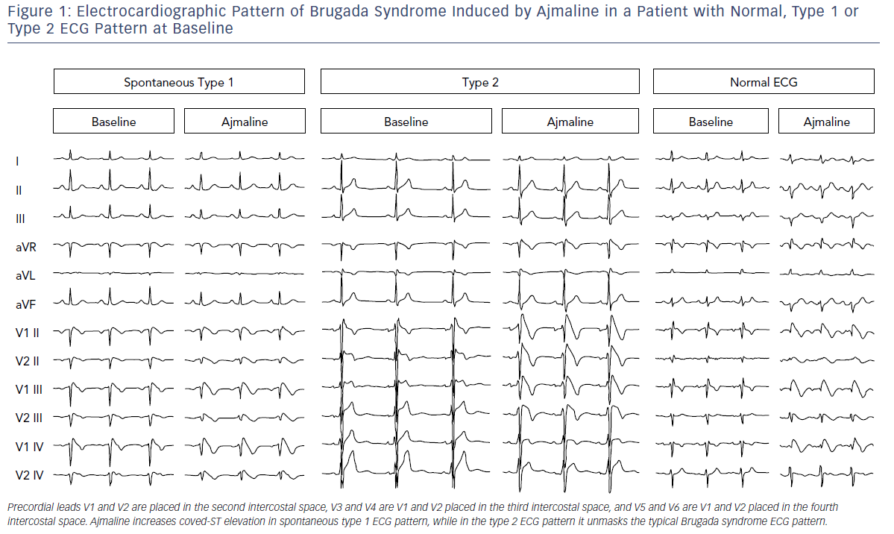
Pappone C, Santinelli V
Electrocardiographic Pattern Of Brugada Syndrome
Citation: Arrhythmia & Electrophysiology Review 2019;8(1):13–8
https://doi.org/10.15420/aer.2018.73.2

