Slide 1

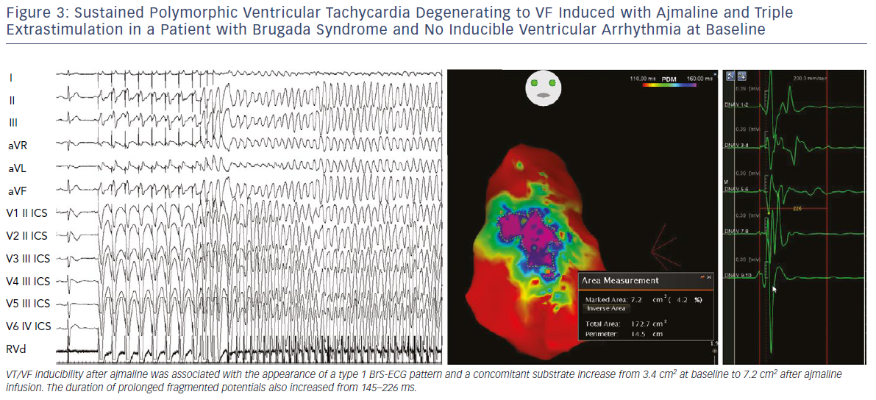
Pappone C, Santinelli V
Sustained Polymorphic Ventricular Tachycardia Degenerating To VF
Citation: Arrhythmia & Electrophysiology Review 2019;8(1):13–8
https://doi.org/10.15420/aer.2018.73.2

