Slide 1
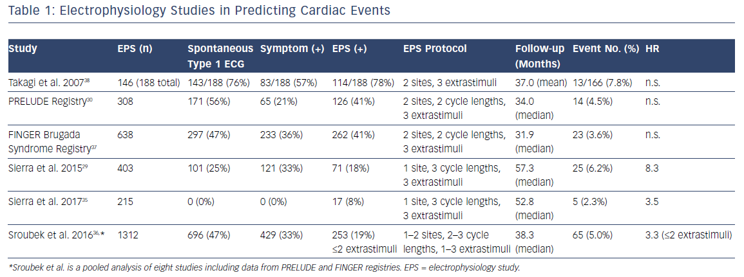
Romero JE, Li DL, Avendano R, Diaz JC, Tung R, Di Biase L
Electrophysiology Studies In Predicting Cardiac Events
Citation: Arrhythmia & Electrophysiology Review 2019;8(1):19–27
https://doi.org/10.15420/aer.2018.66.2

