Slide 1
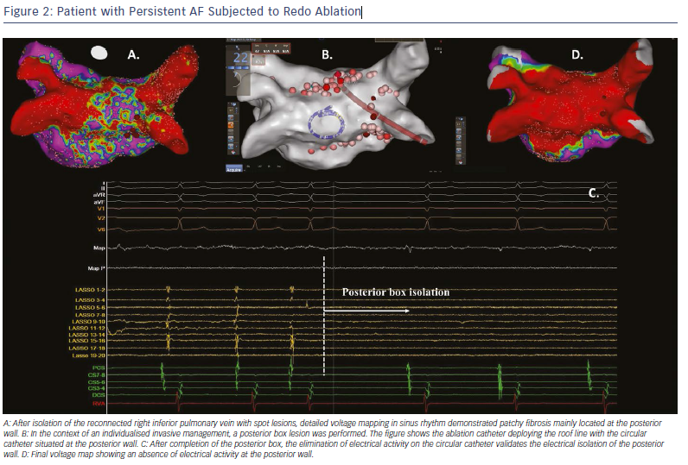
Tzeis S, Asvestas D, Vardas P
Patient with Persistent AF Subjected to Redo Ablation
Citation: Arrhythmia & Electrophysiology Review 2019;8(1):37–41.
https://doi.org/10.15420/aer.2018.79.3

