Slide 1
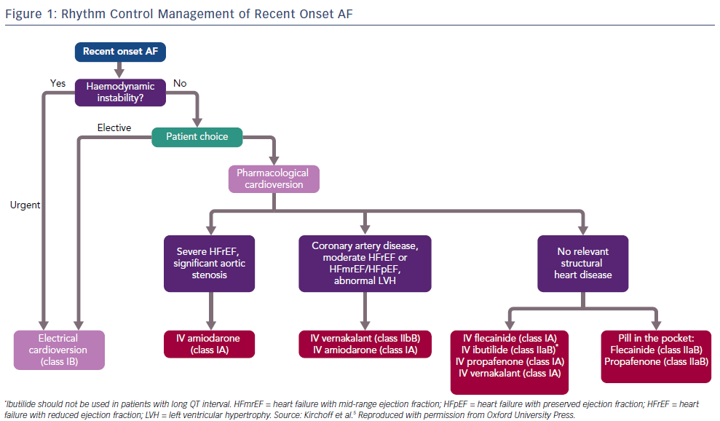
Hall A, Mitchell AR
Rhythm Control Management of Recent Onset AF
Citation: Arrhythmia & Electrophysiology Review 2019;8(1):70–4
https://doi.org/10.15420/aer.2018.71.2

