Slide 1
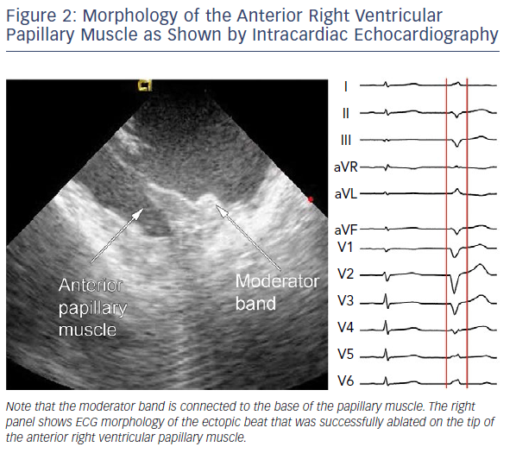
Kautzner J, Peichl P
Morphology Of The Anterior Right Ventricular Papillary Muscle
Citation: Arrhythmia & Electrophysiology Review 2019;8(1):65–9.
https://doi.org/10.15420/aer.2018.80.2

