Slide 1
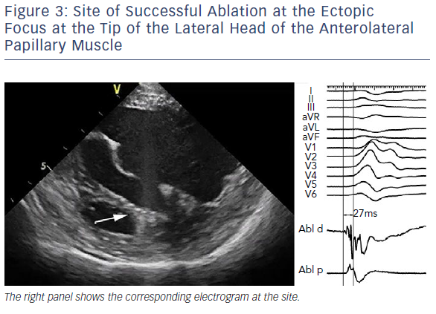
Kautzner J, Peichl P
Site Of Successful Ablation At The Ectopic Focus At The Tip Of The Lateral Head
Citation: Arrhythmia & Electrophysiology Review 2019;8(1):65–9.
https://doi.org/10.15420/aer.2018.80.2

