Slide 1
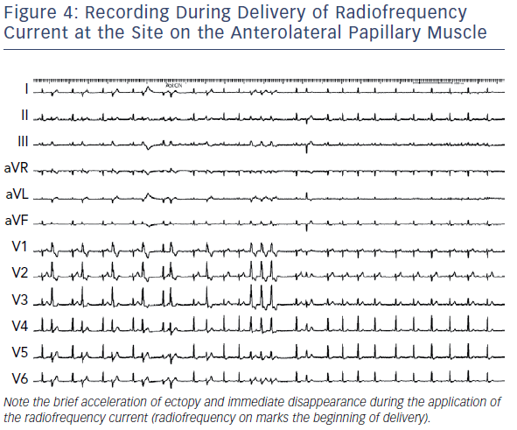
Kautzner J, Peichl P
Recording During Delivery Of Radiofrequency Current At The Site
Citation: Arrhythmia & Electrophysiology Review 2019;8(1):65–9.
https://doi.org/10.15420/aer.2018.80.2

