Slide 1
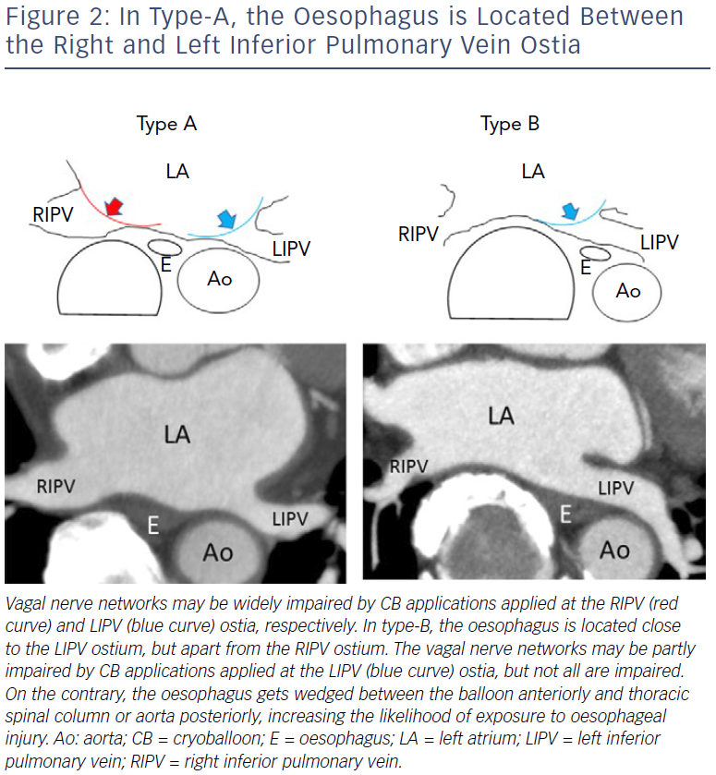
Miyazaki S, Tada H
In Type-A, The Oesophagus Is Located Between The Right And Left Inferior Pulmonary Vein Ostia
Citation: Arrhythmia & Electrophysiology Review 2019;8(1):60–4.
https://doi.org/10.15420/aer.2018.72.2

