Slide 1
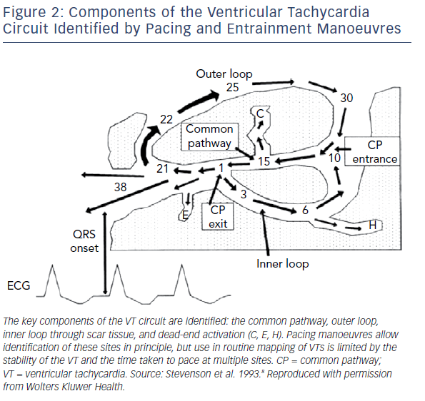
Martin R, Hocini M, Haissaguerre M, Jaïs P, Sacher F
Components Of The Ventricular Tachycardia Circuit Identified By Pacing And Entrainment Manoeuvres
Citation: Arrhythmia & Electrophysiology Review 2019;8(1):54–9.
https://doi.org/10.15420/aer.2018.78.2

