Slide 1
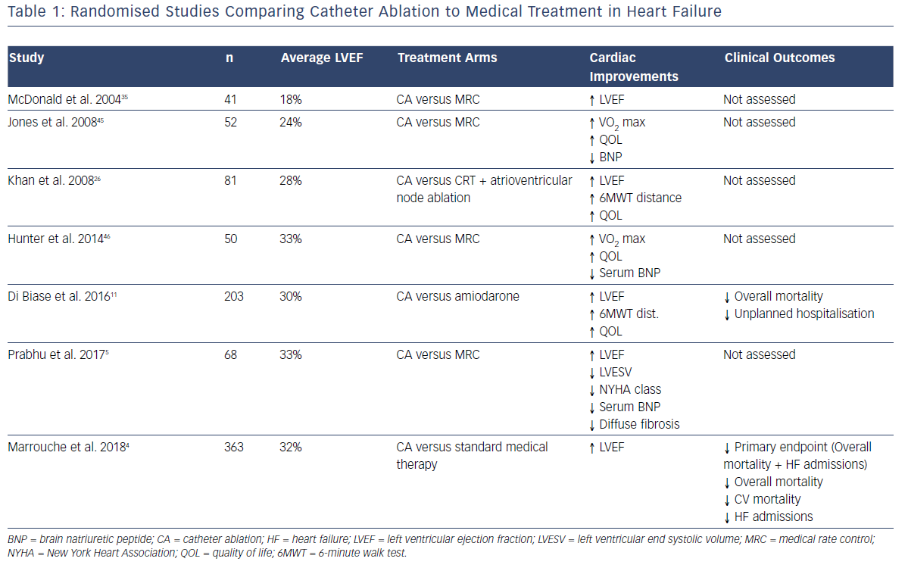
Prabhu S, Lim WH
Randomised Studies Comparing Catheter Ablation To Medical Treatment In Heart Failure
Citation: Arrhythmia & Electrophysiology Review 2019;8(1):47–53.
https://doi.org/10.15420/aer.2019.9.2

