Slide 1
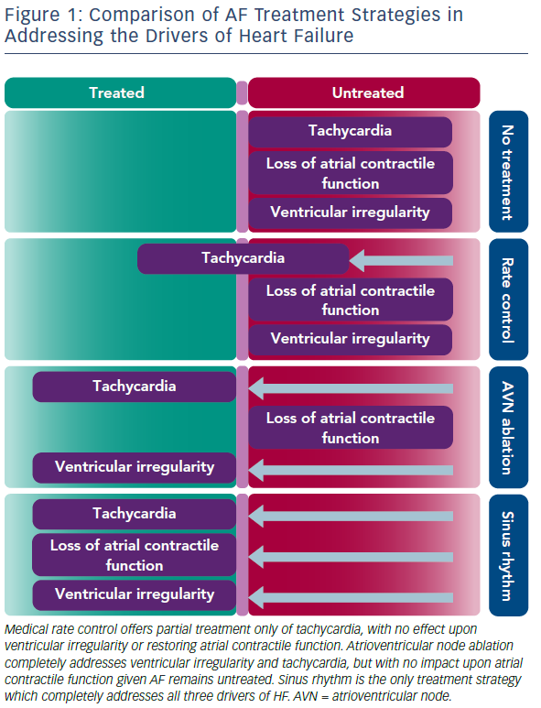
Prabhu S, Lim WH
Comparison Of AF Treatment Strategies In Addressing The Drivers Of Heart Failure
Citation: Arrhythmia & Electrophysiology Review 2019;8(1):47–53.
https://doi.org/10.15420/aer.2019.9.2

