Slide 1
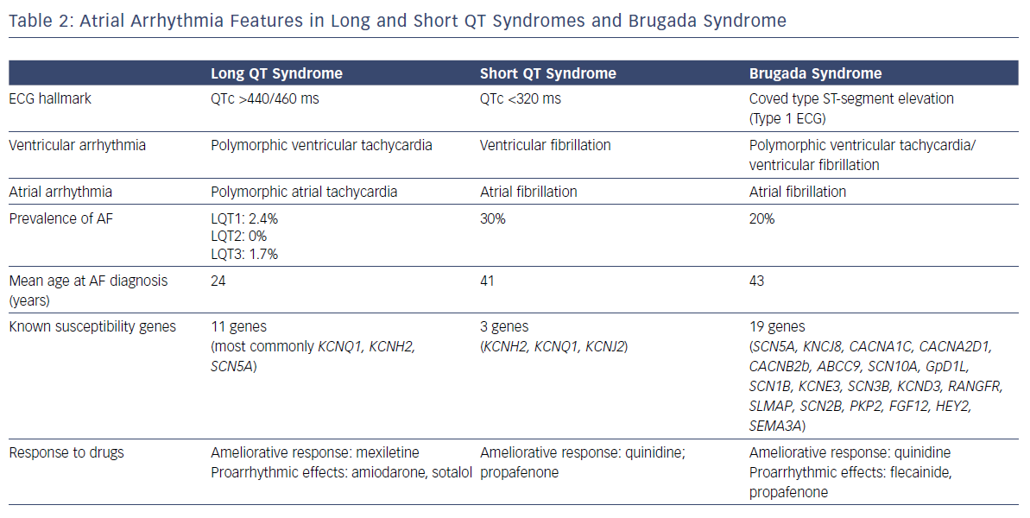
Conte G, Schotten U, Auricchio A
Atrial Arrhythmia Features In Long And Short QT Syndromes And Brugada Syndrome Long
Citation: Arrhythmia & Electrophysiology Review 2019;8(1):42–6.
https://doi.org/10.15420/aer.2019.4.2

