Slide 1
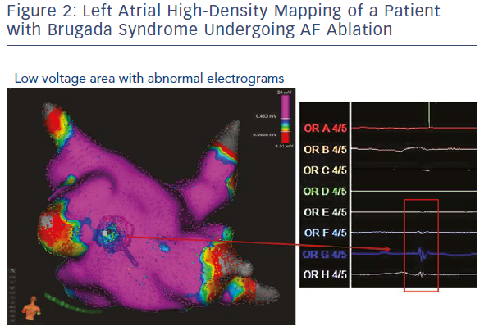
Conte G, Schotten U, Auricchio A
Left Atrial High-Density Mapping Of A Patient With Brugada Syndrome Undergoing AF Ablation
Citation: Arrhythmia & Electrophysiology Review 2019;8(1):42–6.
https://doi.org/10.15420/aer.2019.4.2

