Slide 1
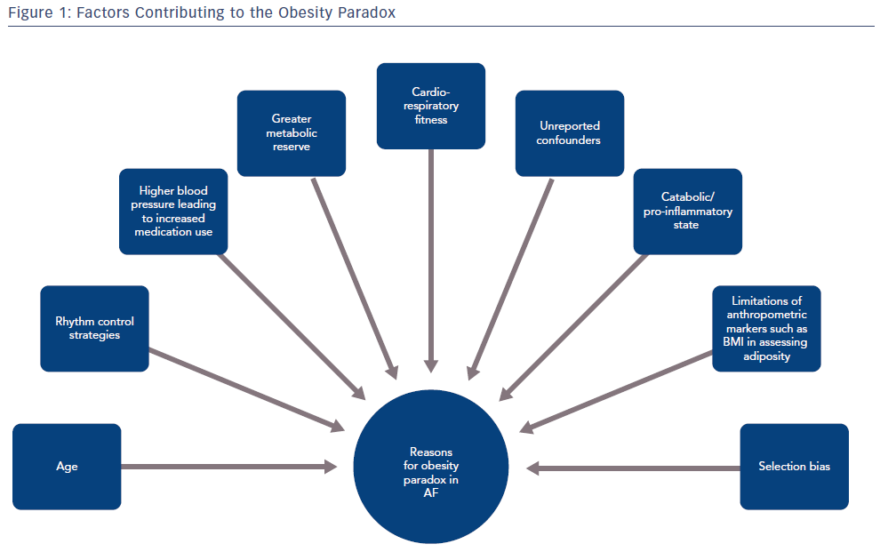
Vyas V, Lambiase PD
Factors Contributing To The Obesity Paradox
Citation: Arrhythmia & Electrophysiology Review 2019;8(1):28–36.
https://doi.org/10.15420/aer.2018.76.2

