Slide 1
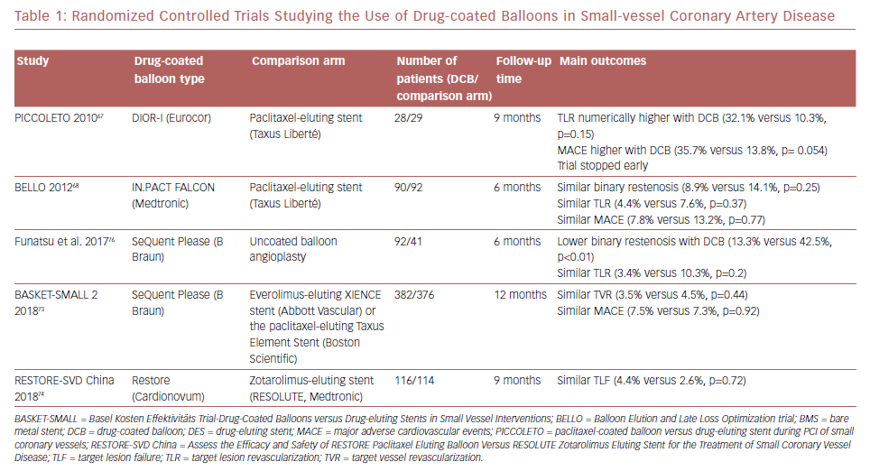
Megaly M, Saad M, Brilakis ES
Randomized Controlled Trials Studying The Use Of Drug-Coated Balloons
Citation: US Cardiology Review 2019;13(1):16–20
https://doi.org/10.15420/usc.2019.4.1

