Slide 1
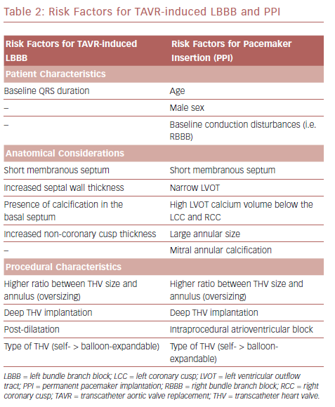
Kanjanauthai S, Bhasin K, Pirelli L, Kliger CA
Risk Factors For TAVR-Induced LBBB And PPI
Citation: US Cardiology Review, 2019;13(1):21–9
https://doi.org/10.15420/usc.2018.7.2

