Slide 1
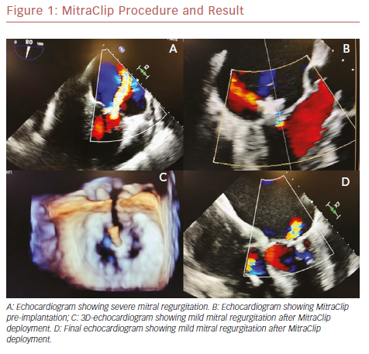
Elbey MA, Dallan LAP, Attizzani GF
MitraClip Procedure And Result
Citation: US Cardiology Review 2019;13(1):30–4
https://doi.org/10.15420/usc.2018.19.1

