Slide 1
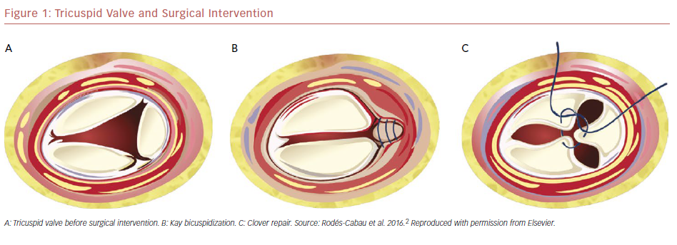
Lin SI, Miura M, Maisano F, Zuber M, Gavazzoni M, Ho EC, Pozzoli A, Taramasso M
Tricuspid Valve And Surgical Intervention
Citation: US Cardiology Review 2019;13(1):35–40
https://doi.org/10.15420/usc.2018.20.1

