Slide 1
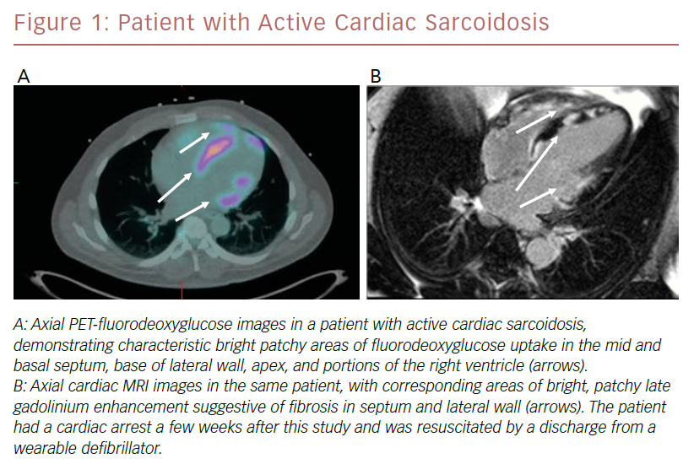
Sigman SR
Patient With Active Cardiac Sarcoidosis
Citation: US Cardiology Review 2019;13(1):41–5
https://doi.org/10.15420/usc.2018.3.1

