Slide 1
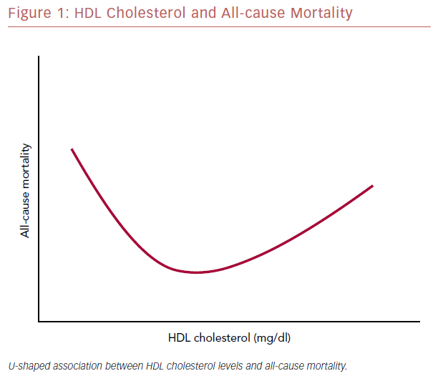
Allard-Ratick MP, Sandesara P, Quyyumi AA, Sperling LS
HDL Cholesterol And All-Cause Mortality
Citation: US Cardiology Review 2019;13(1):49–53
https://doi.org/10.15420/usc.2019.3.2

