Slide 1
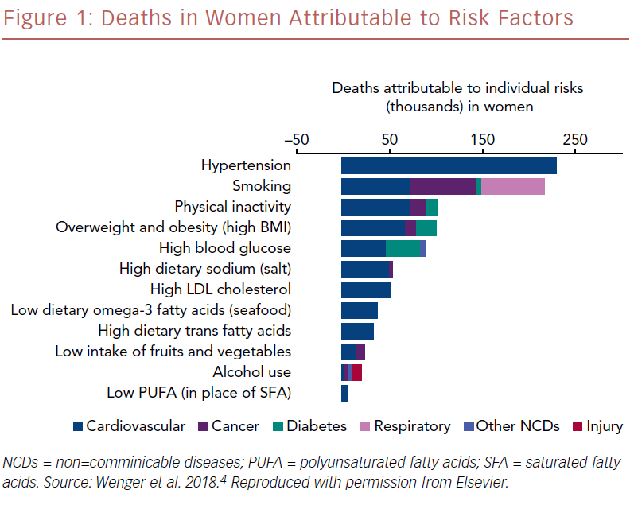
Nadler DL, Poppas A
Deaths In Women Attributable To Risk Factors
Citation: US Cardiology Review 2019;13(1):58–60
https://doi.org/10.15420/usc.2019.5.1

