Slide 1
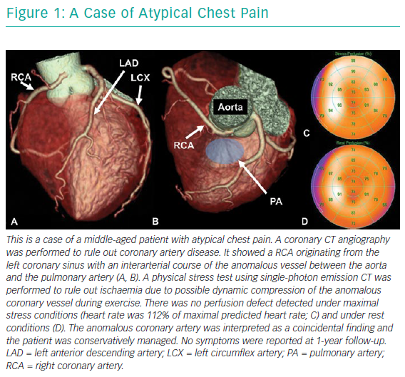
Gräni C, Kaufmann PA, Windecker S, Buechel RR
A Case Of Atypical Chest Pain
Citation: Interventional Cardiology Review 2019;14(2):83–8.
https://doi.org/10.15420/icr.2019.1.1

