Slide 1
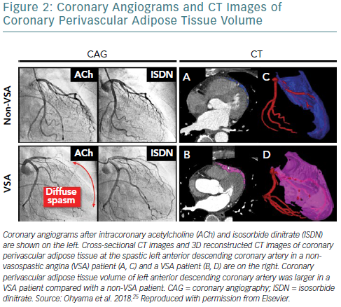
Ohyama K, Matsumoto Y, Shimokawa H
Coronary Angiograms And CT Images Of Coronary Perivascular Adipose Tissue Volume
Citation: European Cardiology Review 2019;14(1):6–9
https://doi.org/10.15420/ecr.2019.3.2

