Slide 1
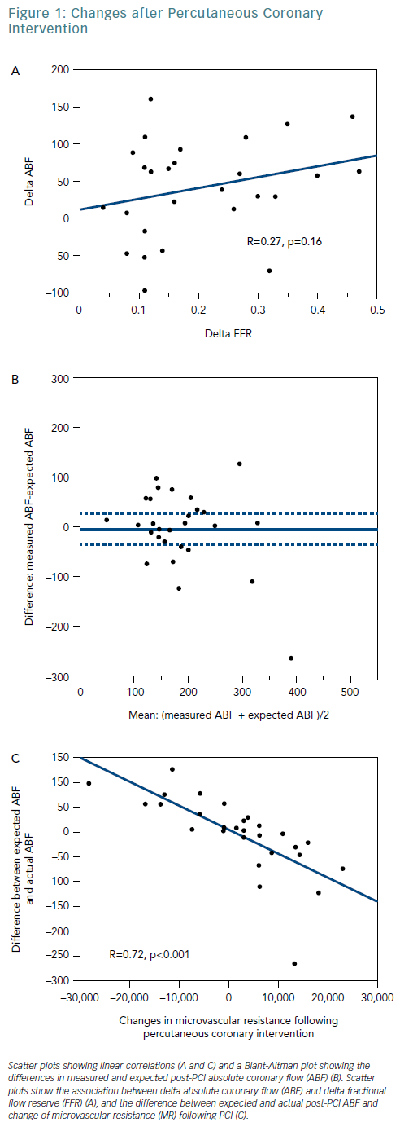
Hamaya R, Kanaji Y, Usui E, Hoshino M, Murai T, Yonetsu T, Kakuta T
Changes After Percutaneous Coronary Intervention
Citation: European Cardiology Review 2019;14(1):10–2
https://doi.org/10.15420/ecr.2018.27.2

