Slide 1
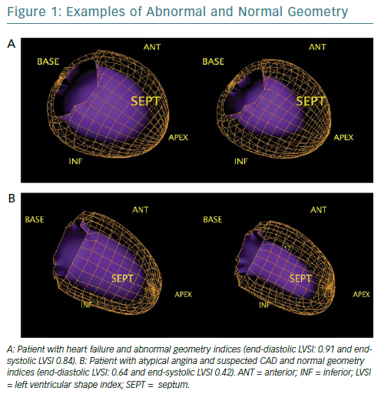
Nappi C, Gaudieri V, Cuocolo A
Examples Of Abnormal And Normal Geometry
Citation: European Cardiology Review 2019;14(1):13–7
https://doi.org/10.15420/ecr.2019.5.1

