Slide 1
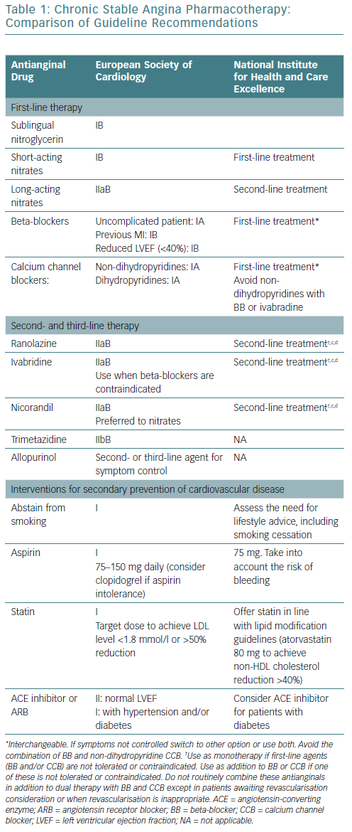
Rousan TA, Thadani U
Chronic Stable Angina Pharmacotherapy Comparison Of Guideline Recommendations
Citation: European Cardiology Review 2019;14(1):18–22
https://doi.org/10.15420/ecr.2018.26.1

