Slide 1
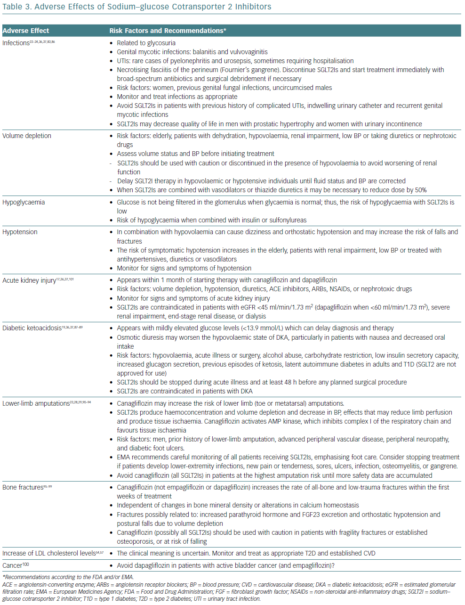
Tamargo J
Adverse Effects Of Sodium–Glucose Cotransporter 2 Inhibitors
Citation: European Cardiology Review 2019;14(1):23-32
https://doi.org/10.15420/ecr.2018.34.2

