Slide 1
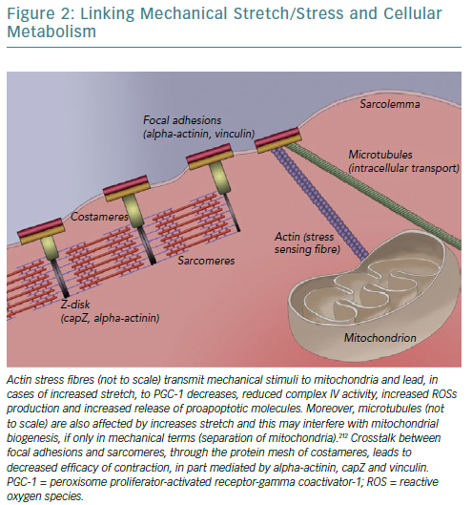
Antoniou CK, Manolakou P, Magkas N, Konstantinou K, Chrysohoou C, Dilaveris P, Gatzoulis KA, Tousoulis D
Linking Mechanical Stretch
Citation: European Cardiology Review 2019;14(1):33–44
https://doi.org/10.15420/ecr.2019.2.2

