Slide 1
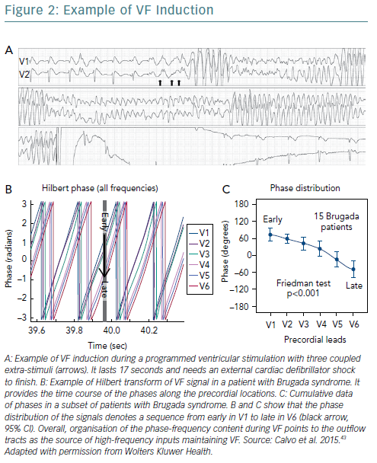
García Iglesias D, Rubín J, Pérez D, Morís C, Calvo D
Example Of VF Induction
Citation: European Cardiology Review 2019;14(1):45–9
https://doi.org/10.15420/ecr.2018.31.2

