Slide 1
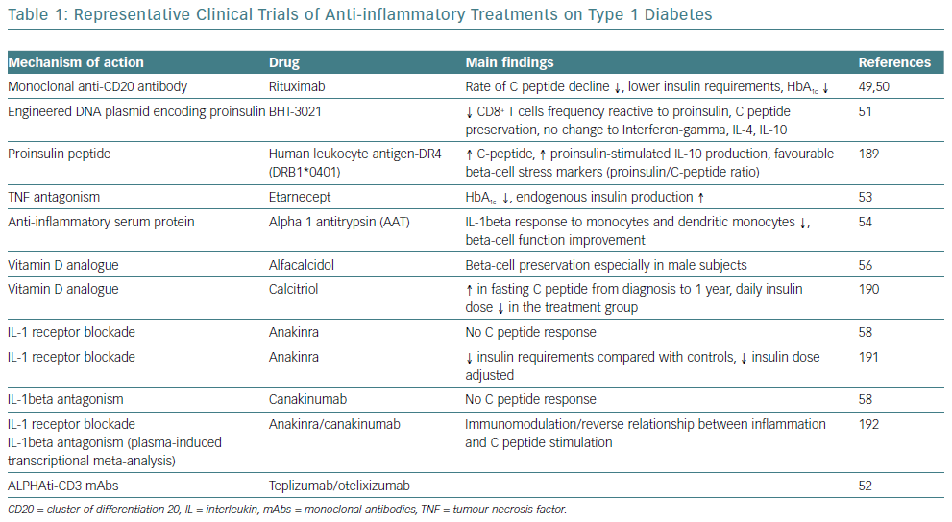
Tsalamandris S, Antonopoulos AS, Oikonomou E, Papamikroulis GA, Vogiatzi G, Papaioannou S, Deftereos S, Tousoulis D
Representative Clinical Trials Of Anti-Inflammatory
Citation: European Cardiology Review 2019;14(1):50–9
https://doi.org/10.15420/ecr.2018.33.1

