Slide 1
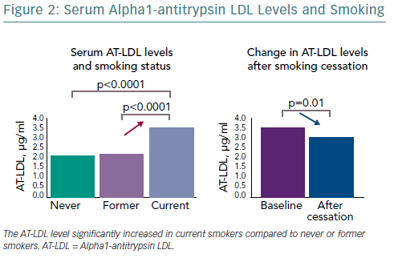
Hasegawa K, Komiyama M, Takahashi Y
Serum Alpha1-Antitrypsin LDL Levels And Smoking
Citation: European Cardiology Review 2019;14(1):60–1
https://doi.org/10.15420/ecr.2019.4.2

