Slide 1
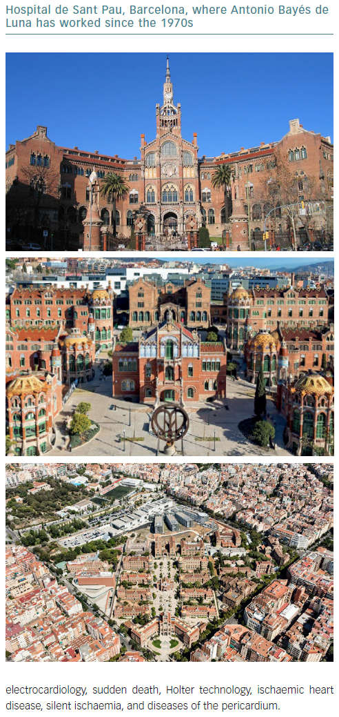
Bayés de Luna A
Hospital de Sant Pau Barcelona
Citation: European Cardiology Review 2019;14(1):68–71
https://doi.org/10.15420/ecr.2019.14.1.CM1

