Slide 1
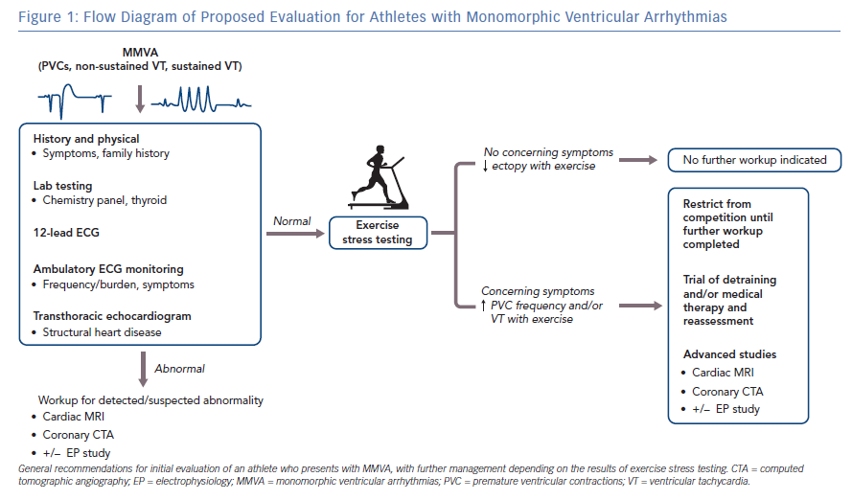
Hsu JJ, Nsair A, Aboulhosn JA, Horwich TB, Dave RH, Shannon KM, Boyle NG, Shivkumar K, Bradfield JS
Flow Diagram of Proposed Evaluation for Athletes with Monomorphic Ventricular Arrhythmias
Citation: Arrhythmia & Electrophysiology Review 2019;8(2):83–9.
https://doi.org/10.15420/aer.2019.19.3

