Slide 1
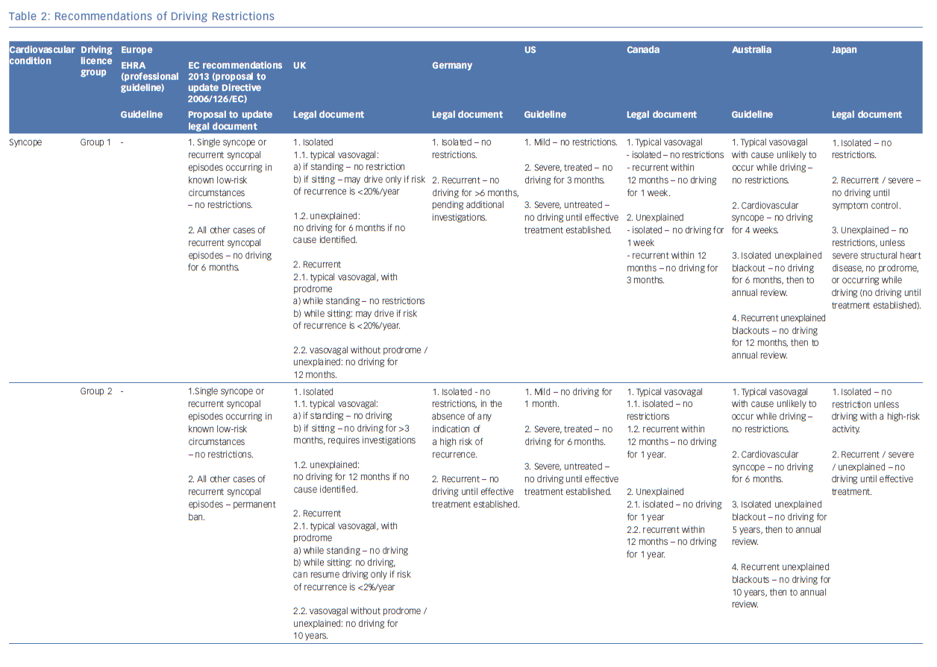
Mărgulescu AD, Anderson MH
Recommendations of Driving Restrictions
Citation: Arrhythmia & Electrophysiology Review 2019;8(2):90–8.
https://doi.org/10.15420/aer.2019.13.2

