Slide 1
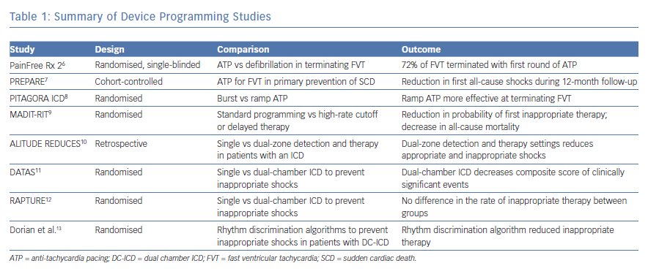
Back S, Kowey PR
Summary of Device Programming Studies
Citation: Arrhythmia & Electrophysiology Review 2019;8(2):99–104.
https://doi.org/10.15420/aer.2018.55.5

