Slide 1
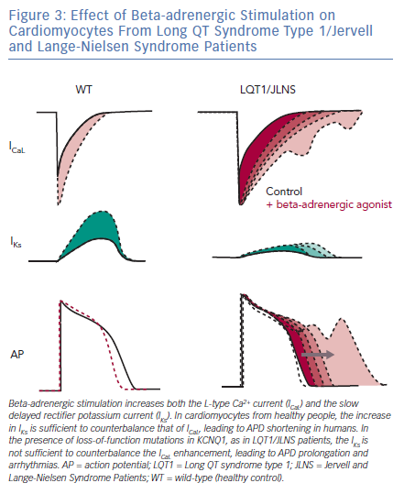
Sala L, Gnecchi M, Schwartz PJ
Effect of Beta-adrenergic Stimulation on Cardiomyocytes
Citation: Arrhythmia & Electrophysiology Review 2019;8(2):105–10.
https://doi.org/10.15420/aer.2019.1.1

