Slide 1
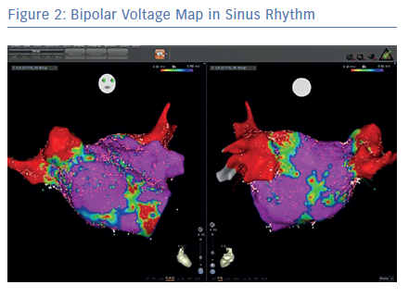
Andronache M, Drca N, Viola G
Bipolar Voltage Map in Sinus Rhythm
Citation: Arrhythmia & Electrophysiology Review 2019;8(2):111–5.
https://doi.org/10.15420/aer.2018.57.1

