Slide 1
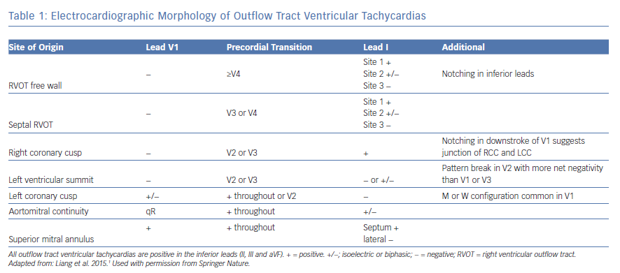
Liang JJ, Shirai Y, Lin A, Dixit S
Electrocardiographic Morphology of Outflow Tract Ventricular Tachycardias
Citation: Arrhythmia & Electrophysiology Review 2019;8(2):116–21
https://doi.org/10.15420/aer.2019.6.2

